Slide 1





Contact Filter Features
Fauzi Sholichin
fauzisholih@gmail.com
+6289673732142
https://www.linkedin.com/in/fauzisho/

Slide 2
Introduction
Search Contact
Filter by Gender (new API)
Male
Female
No Filter

Slide 3
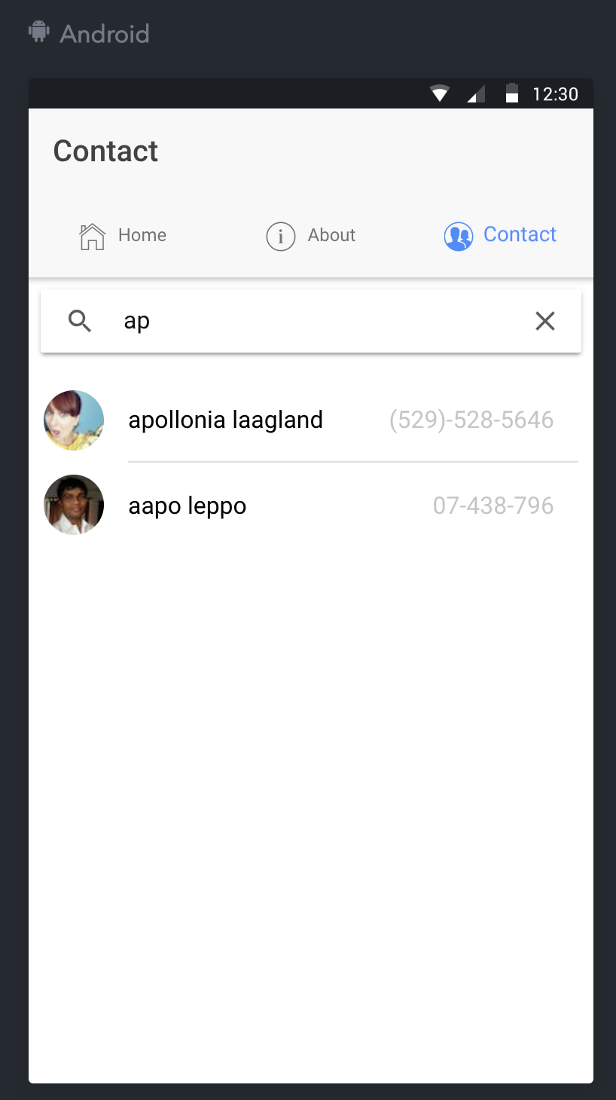
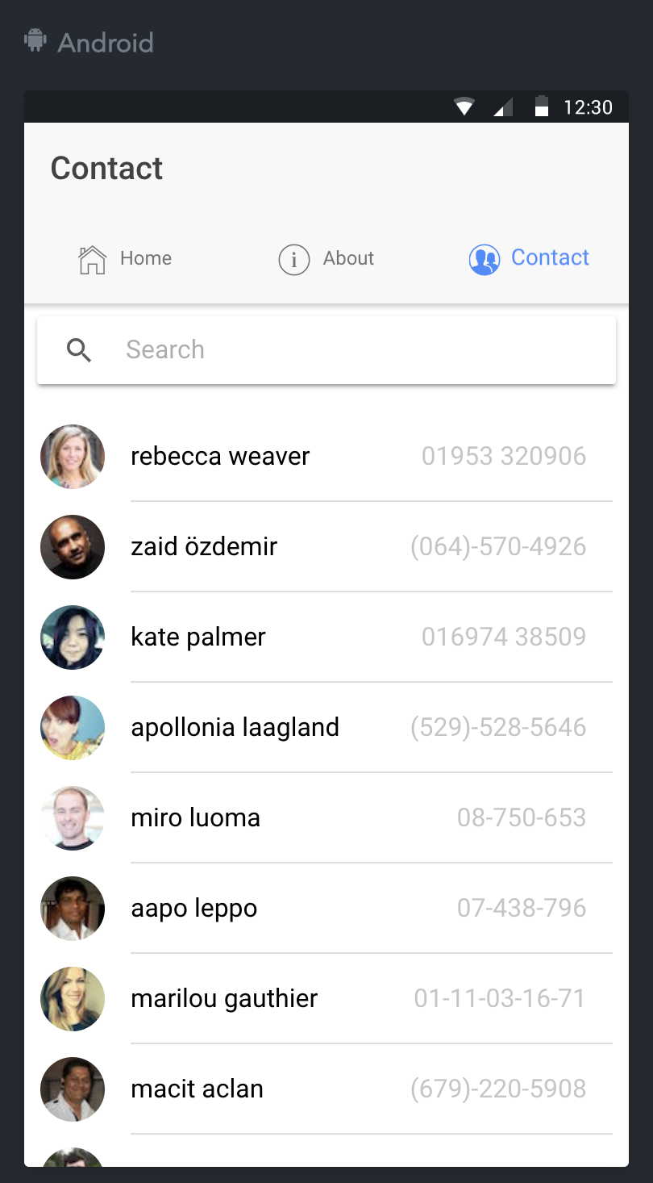
Search Contact

Slide 4
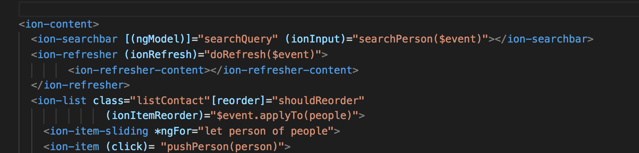
Search Contact
contact.html

Slide 5
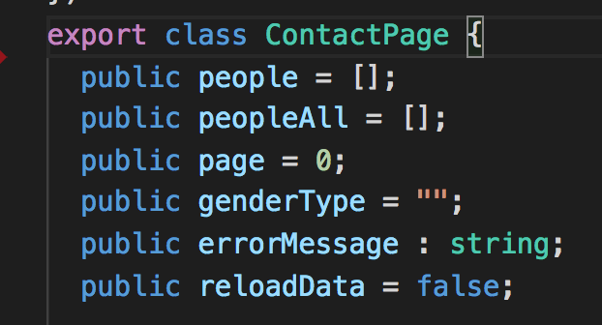
Search Contact
contact.ts

Slide 6
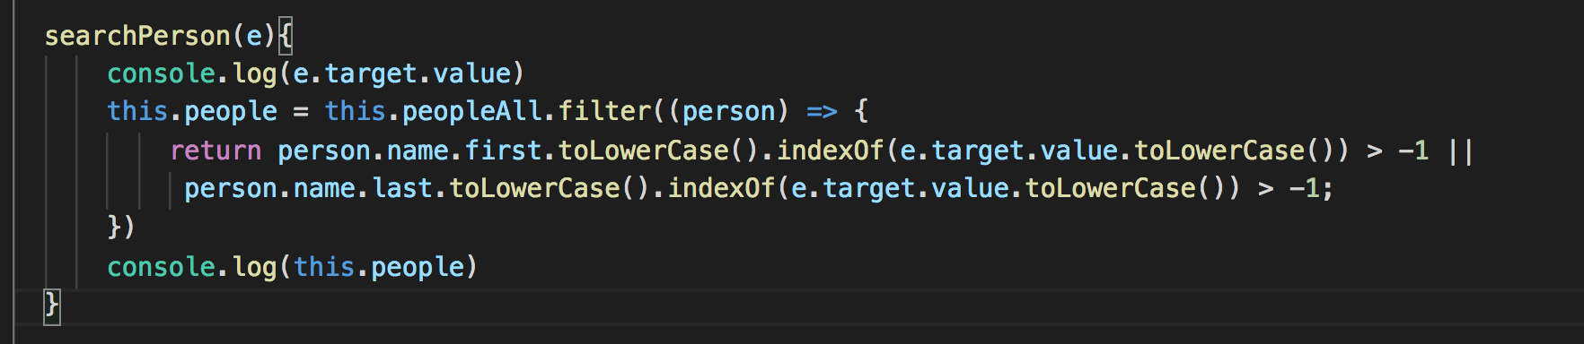
Search Contact
contact.ts

Slide 7
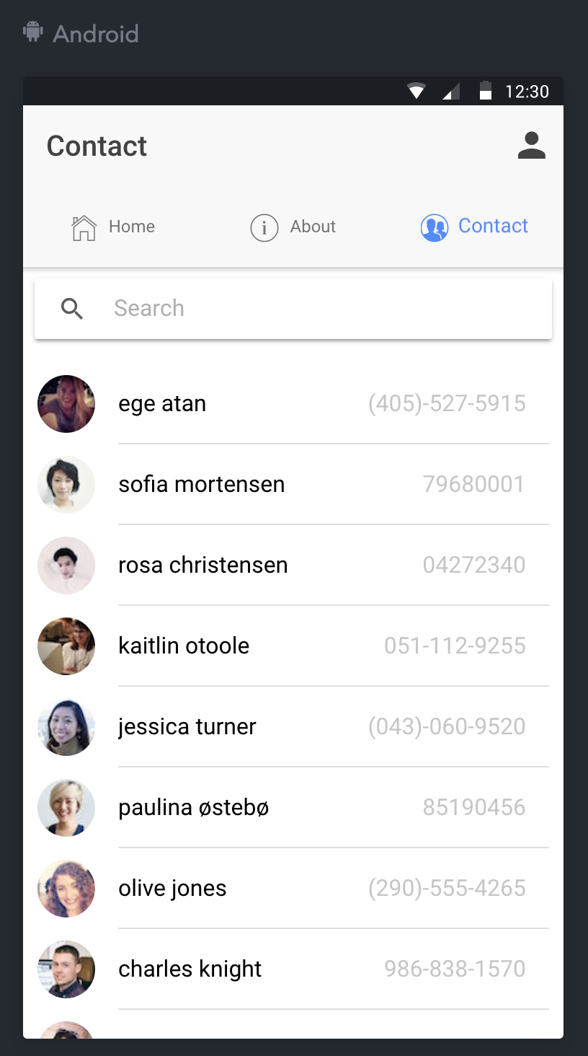
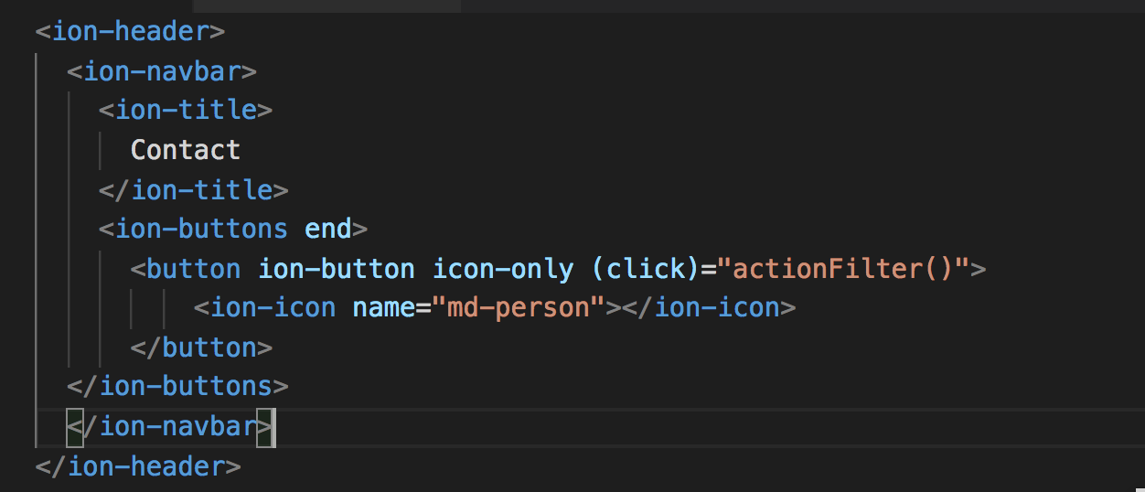
Filter by Gender (new API)
contact.html

Slide 8
Filter by Gender (new API)
contact.html

Slide 9
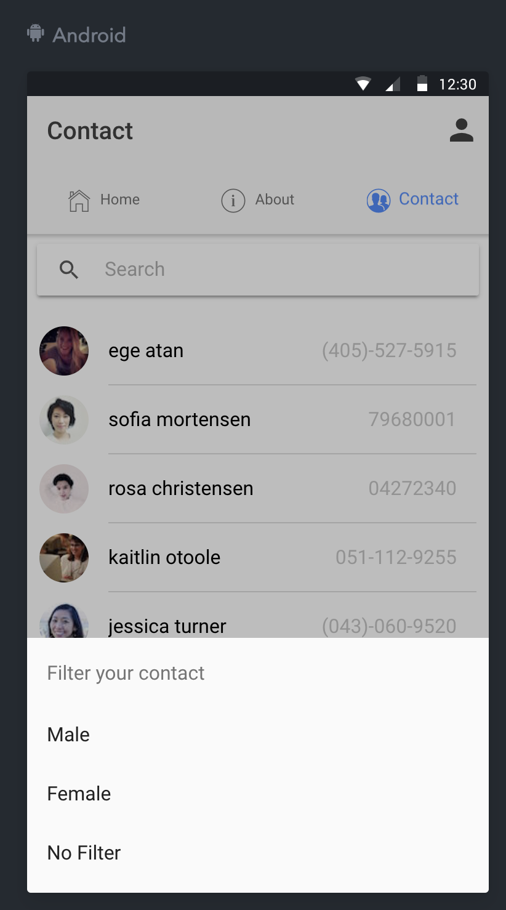
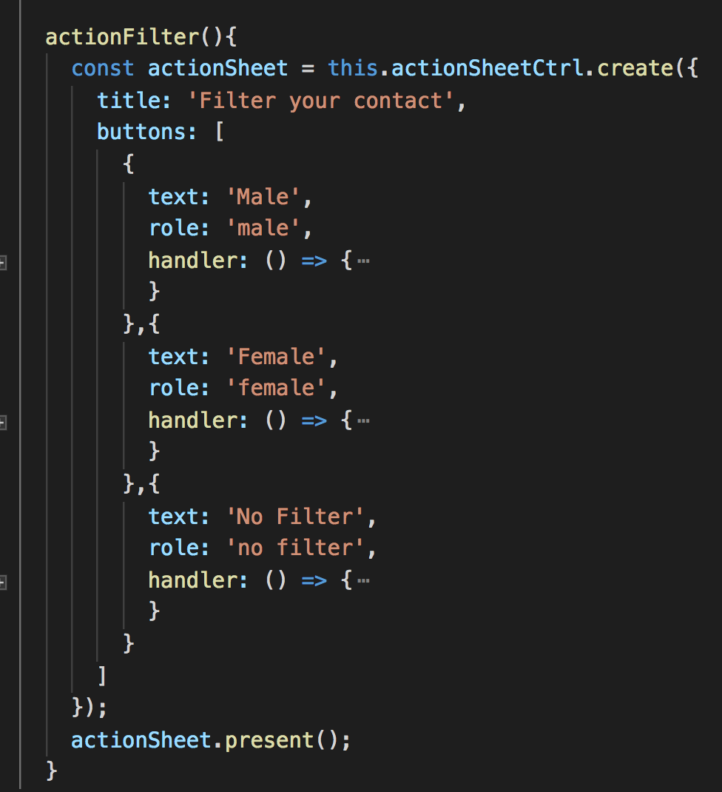
Filter by Gender (new API)
contact.ts

Slide 10
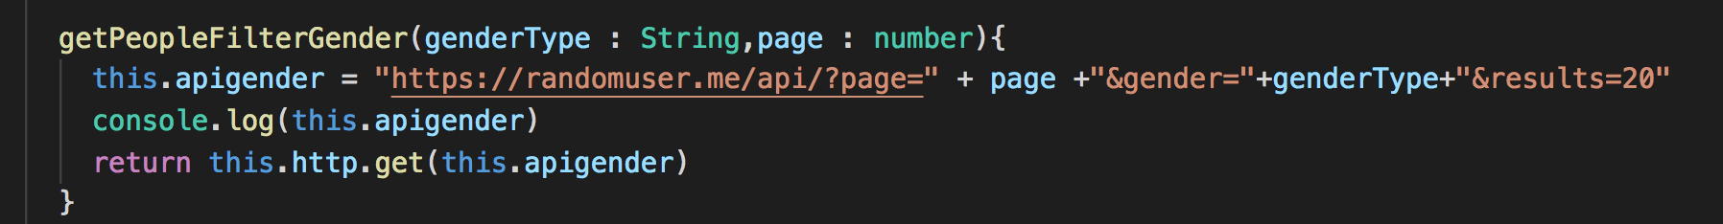
Add new API
people.ts

Slide 11
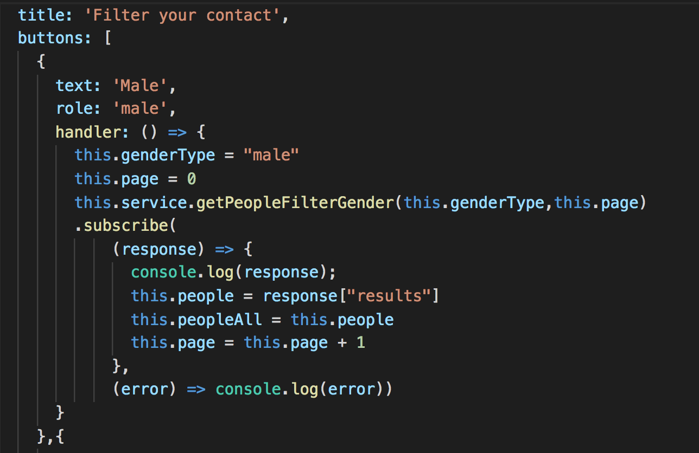
Filter by Gender Male
contact.ts

Slide 12
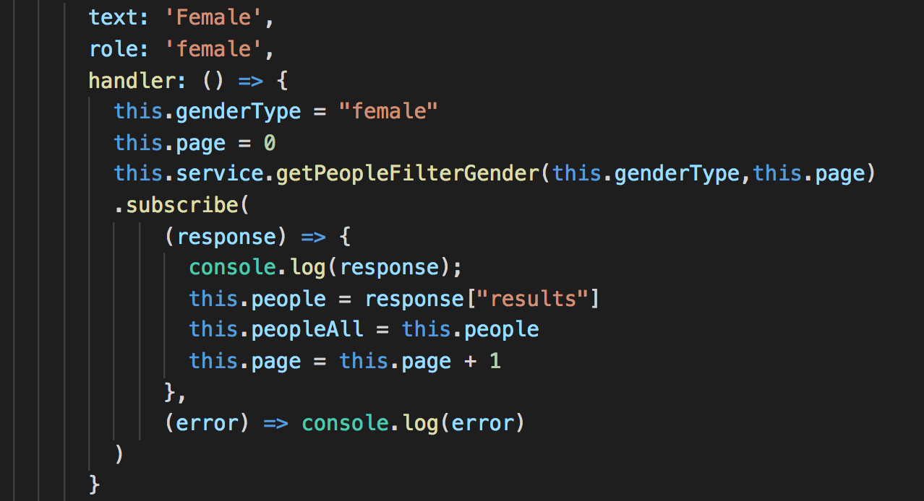
Filter by Gender Female
contact.ts

Slide 13
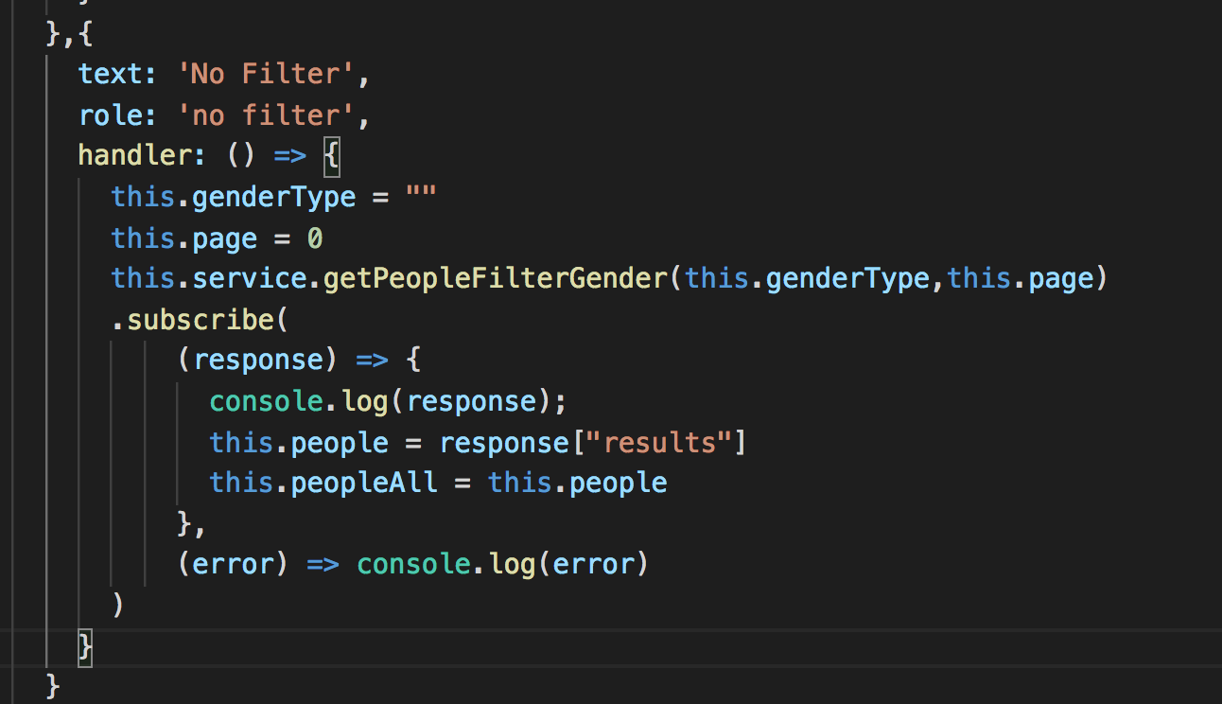
No Filter
contact.ts

